Slide 1
Task 1.3 Human Needs & Motivations
By : Minal Bombatkar

Slide 2

A Study on Triggers & Frictions: Airbnb Application
As frequent travel, I need to use Airbnb application, for booking house during travel stay.
It has very good features that help to experience the local places.

Slide 3

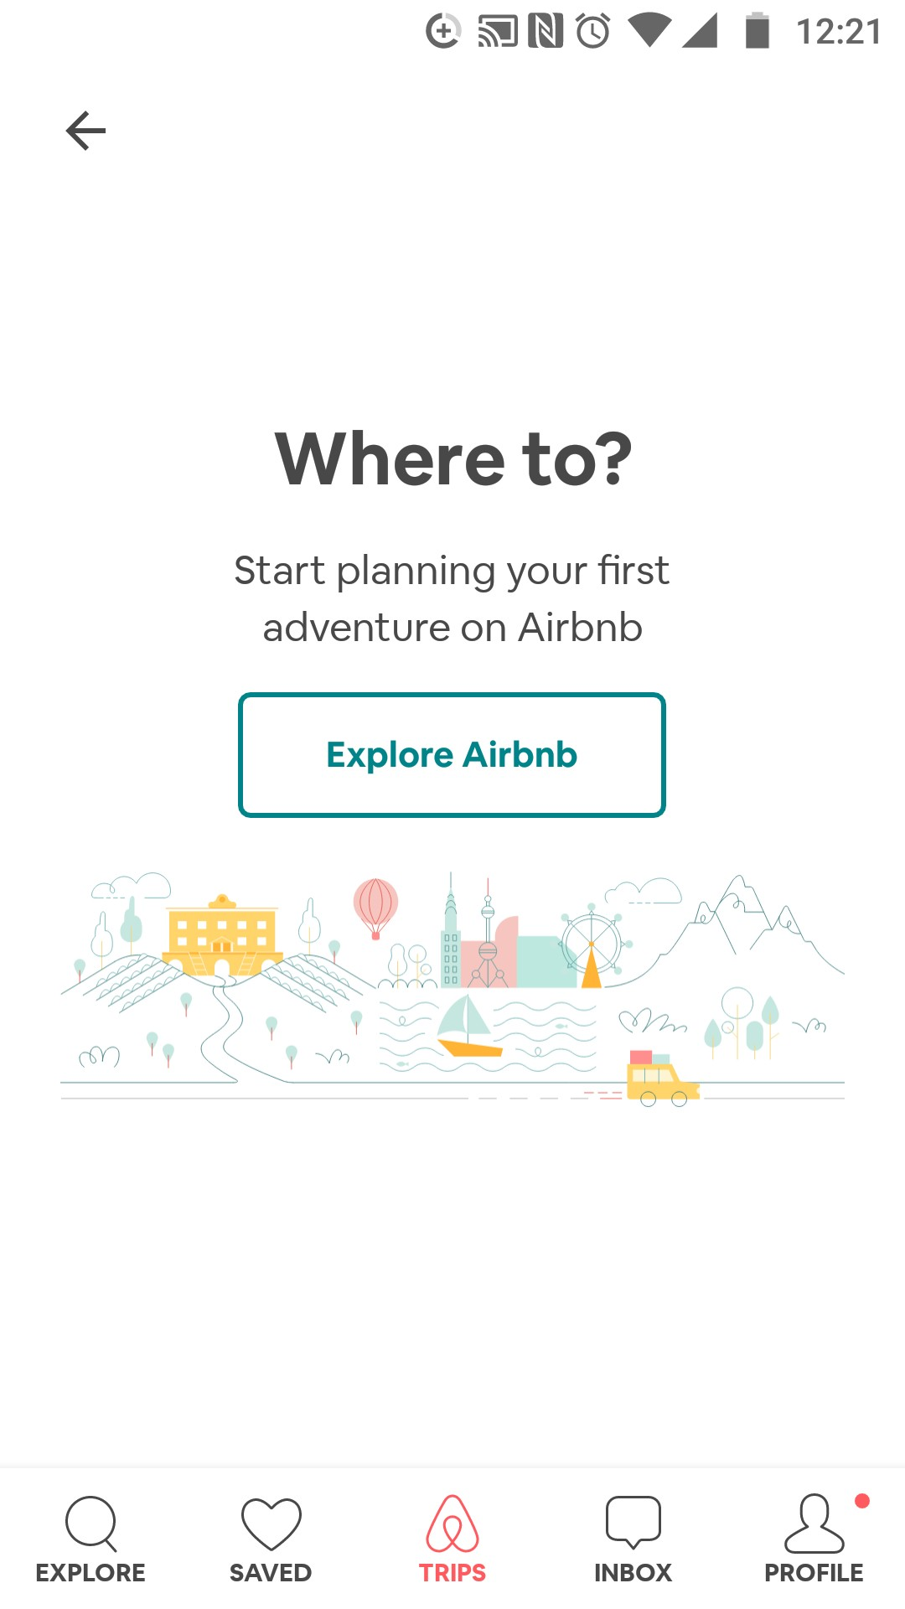
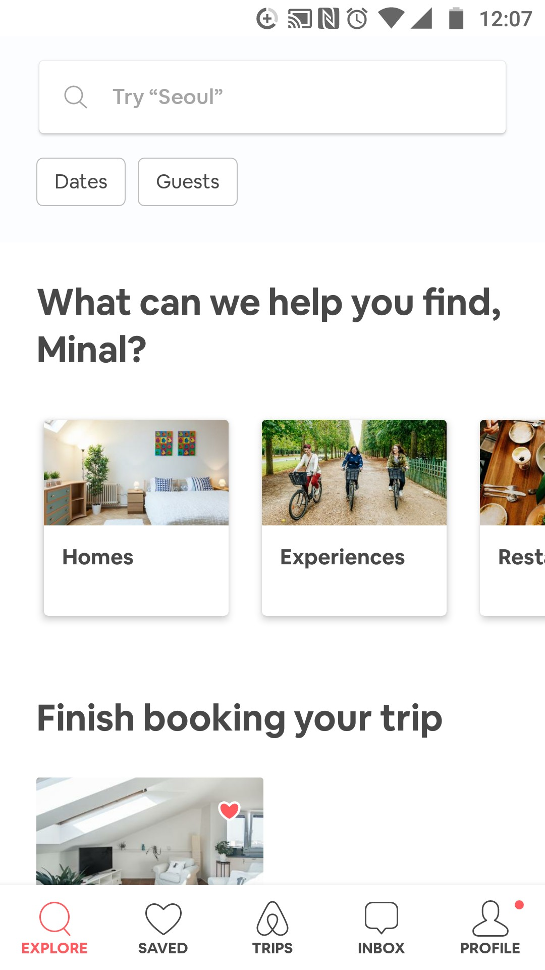
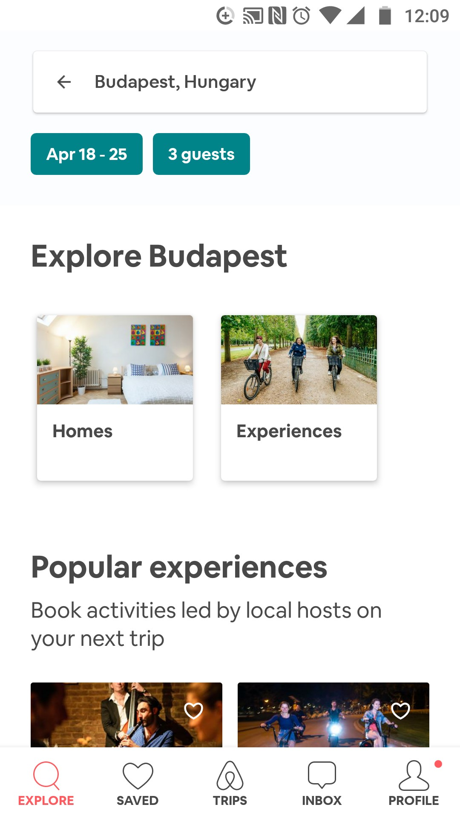




TRIGGERS: Usability and Creativity
After sign in/ sign up process, it open the explorer page, where user find it’s three main menus – Homes, Experiences, Restaurant. This page allow the user to scroll down through its News, Blogs and Sale
FRICTION: Usability
If the user need to find the home for booking , the search option is too small as compare to the list of news on explorer page. Some time user district from the goals. After entering the details such as date and number of guests, it again shows same explorer page with users selection of data. Instate of showing the list of Homes.
Again at Explore page with user data
Home page
Explore page

Slide 4
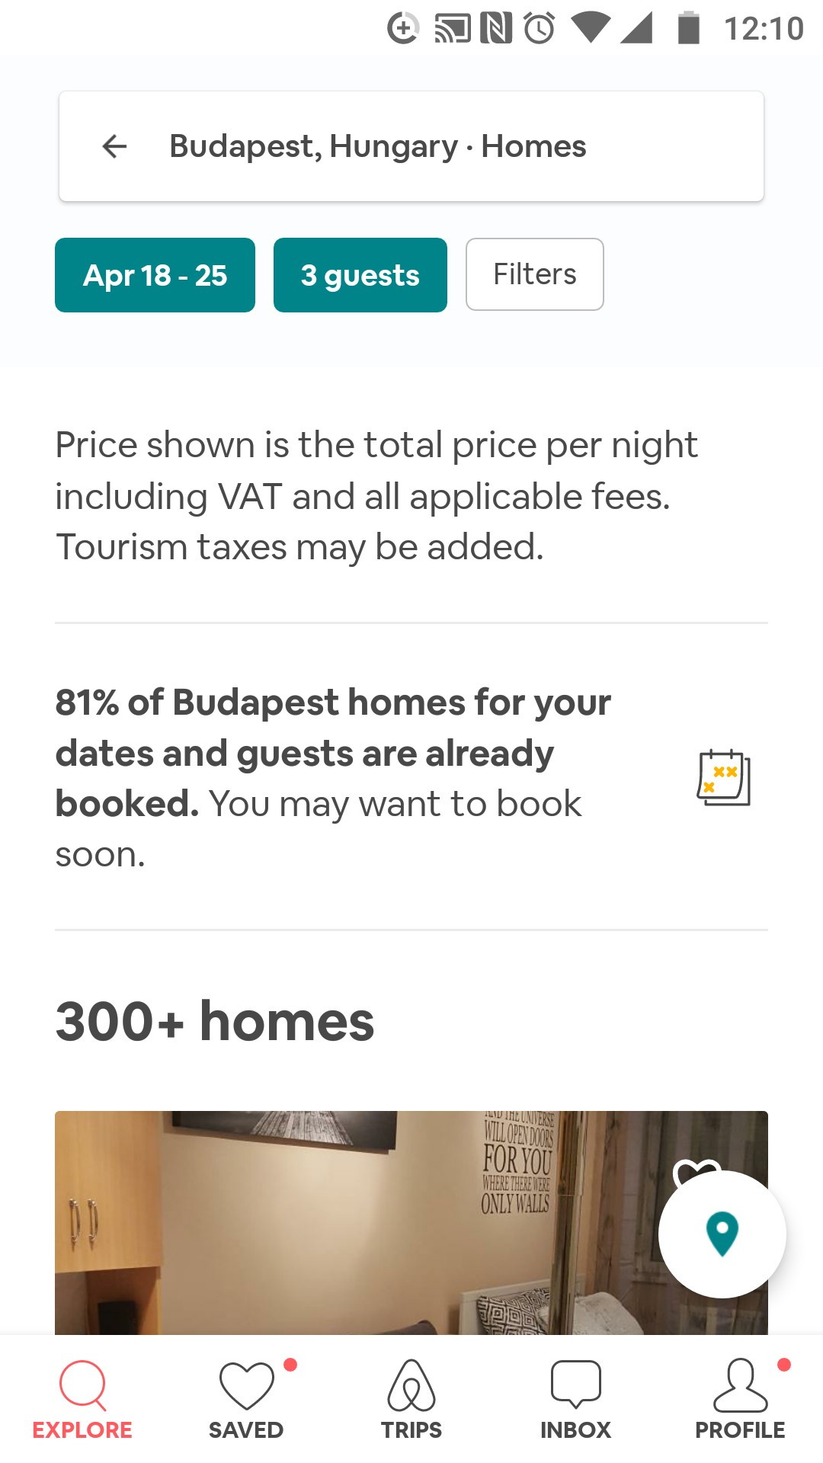
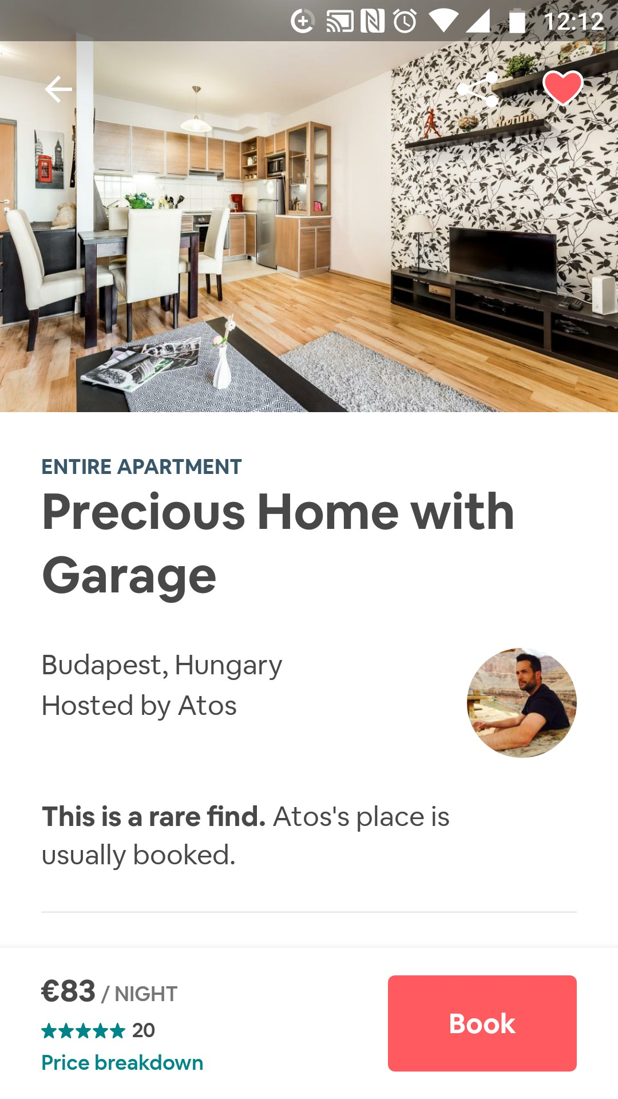
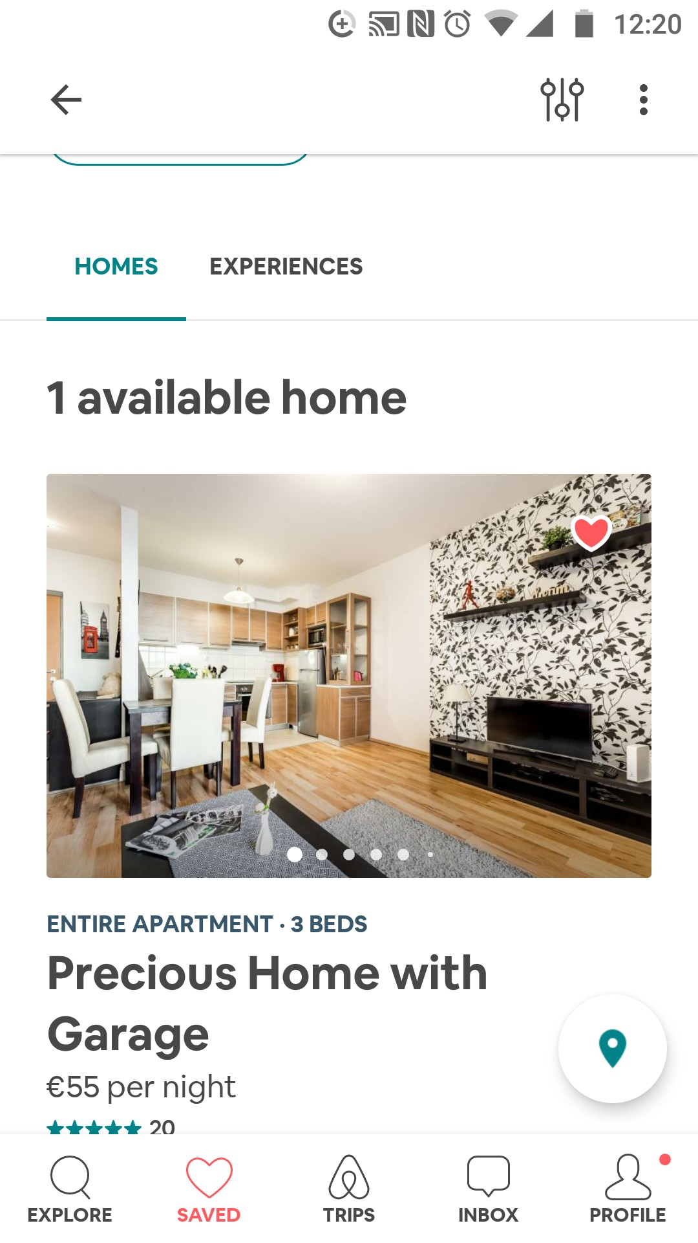
TRIGGERS: Usability and Functionality
When user searching through list of Homes, able to save into favourite and would create own list as per user requirement. It provide very good view of property and amenities provided by host. Also at the bottom user can read reviews and rating of that property.
FRICTION: Functionality
If the user want to add multiple items in list before booking to compare, it allows to do it. But when click on “Saved” button to see the saved list, it shows just recent saved one item.
Save to the favourite
Inside view of list
Only one item in the list of saved

Slide 5
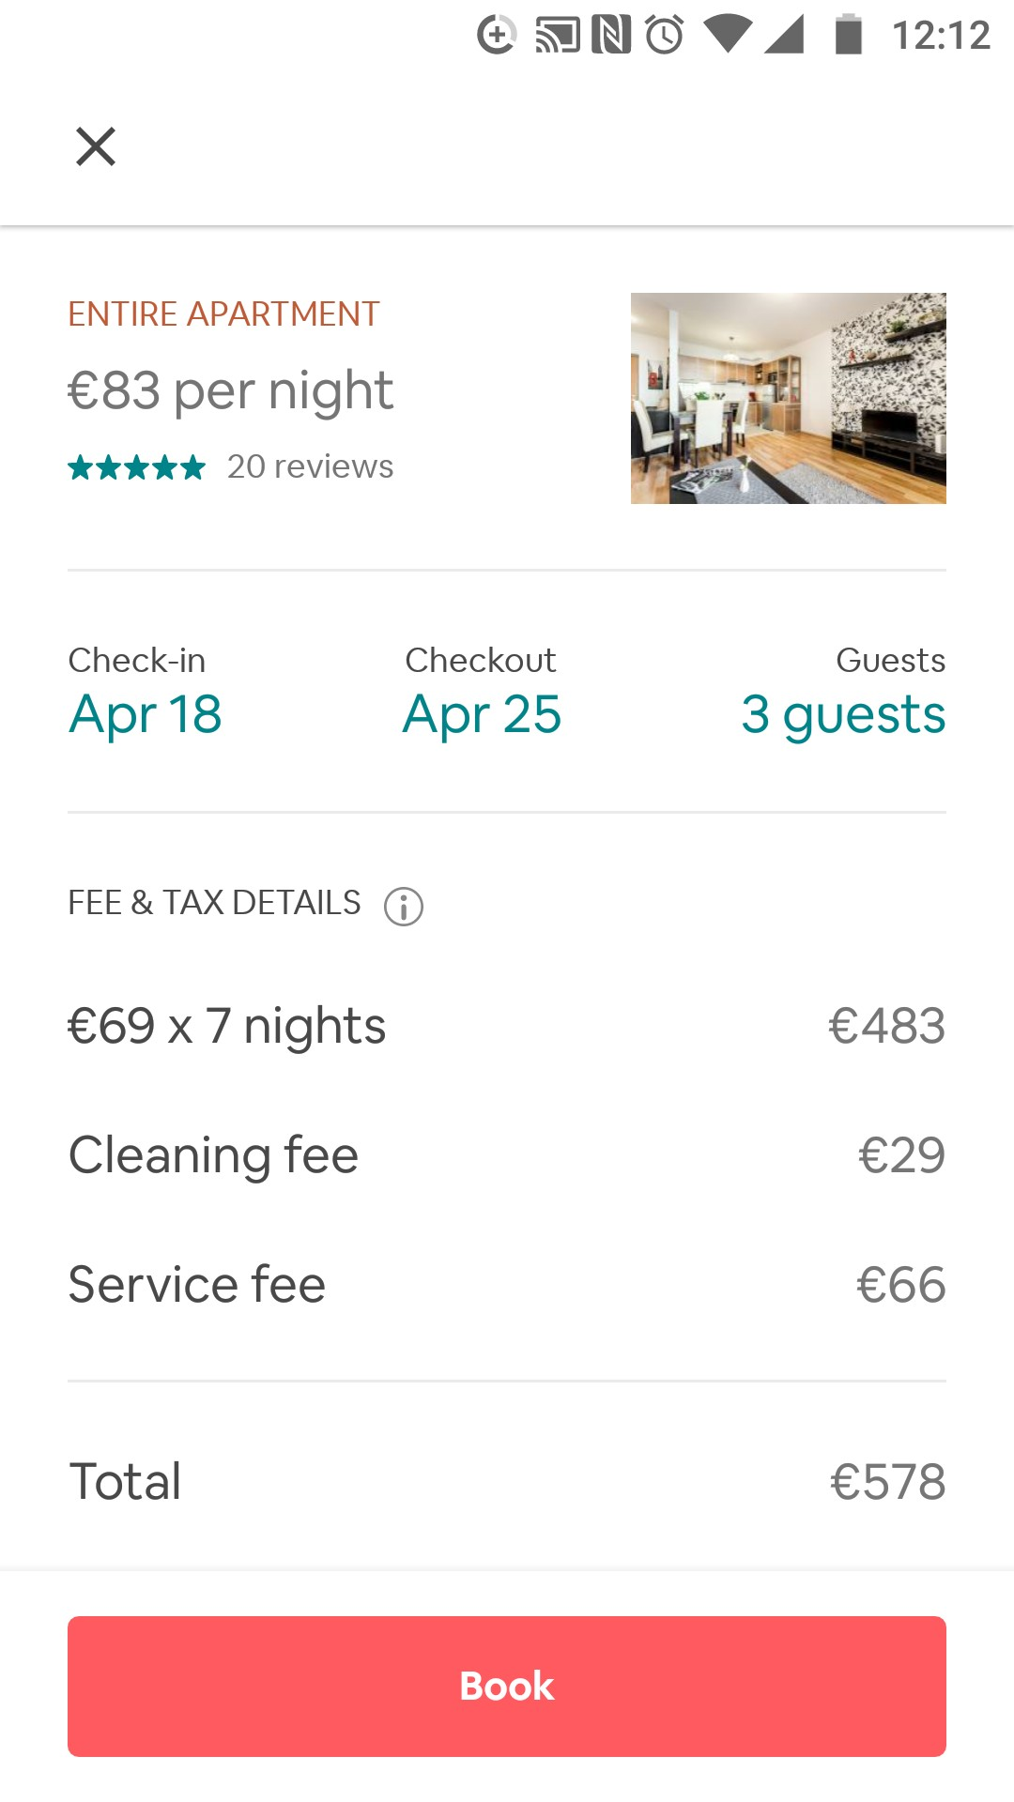
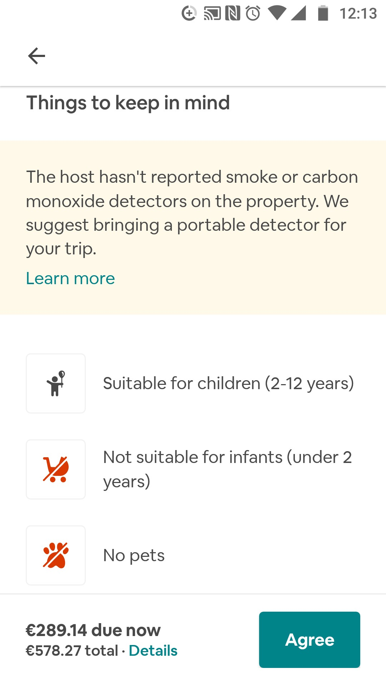
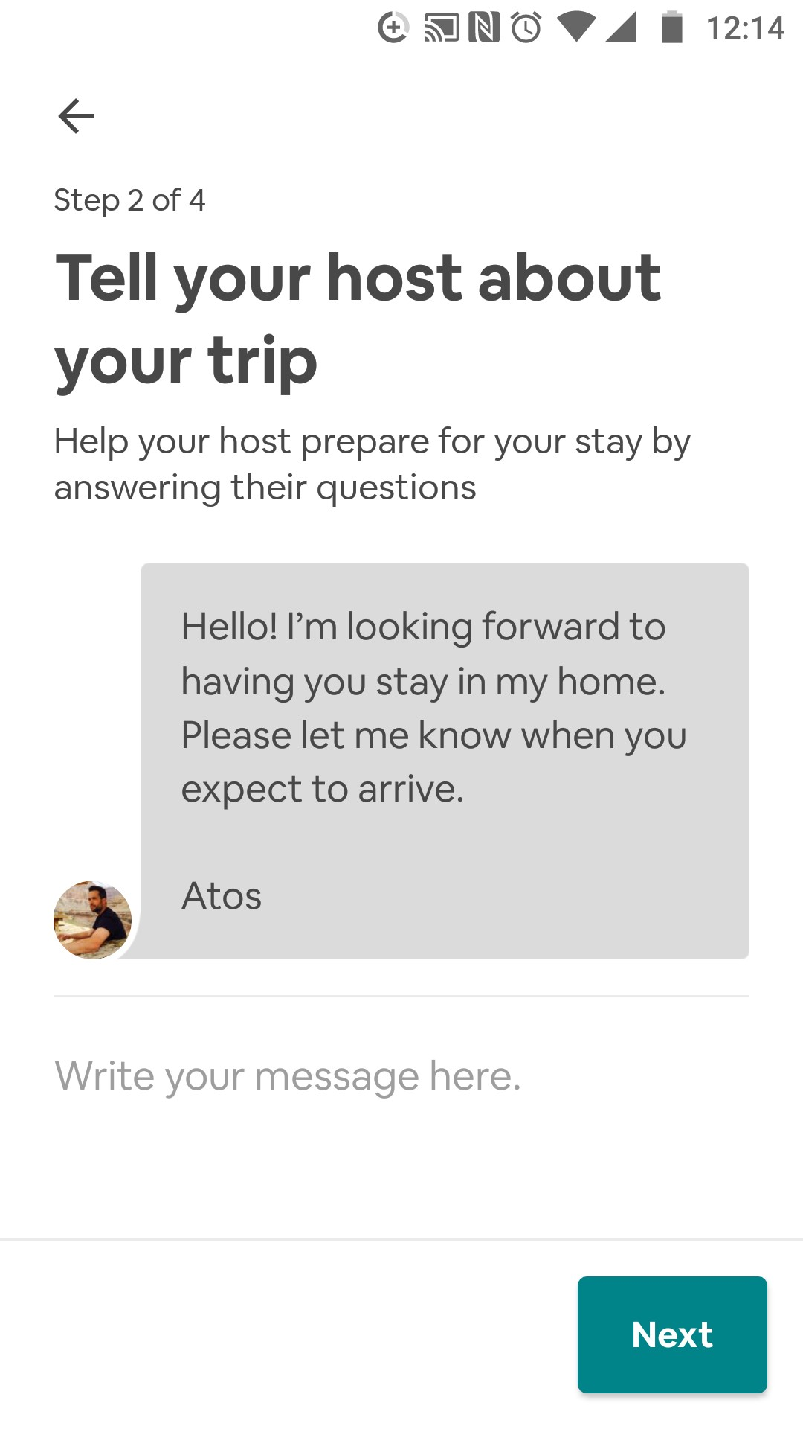
TRIGGERS: Usability and Creativity
When user finalised with the Home and ready to book, it is simple to do online payment options is available. It help the user to connect with the Host, so that user would discuss the plan before reached out.
FRICTION: Usability
To complete the Booking process user go through the 5 steps and on 3 ed step, app shows the “Things to keep in mind” page. There are mention the facts like “No pets, Not suitable for Kids, No smoke detector in home”. This page would be mention on the home page of that property. So that it will save time of user, If user don’t agree on these facts.
Booking page
Friction page
Get to know the Host of Home

Slide 6
Overview:
Airbnb is widely used application for booking the Home during holiday. It help to make holidays more comfortable by providing the Homes and apartments. It proves that developers use all possible scenario's and testing tools to be effective to satisfies the users requirements. This app does not have much friction except some suggestions.

